Slide 1
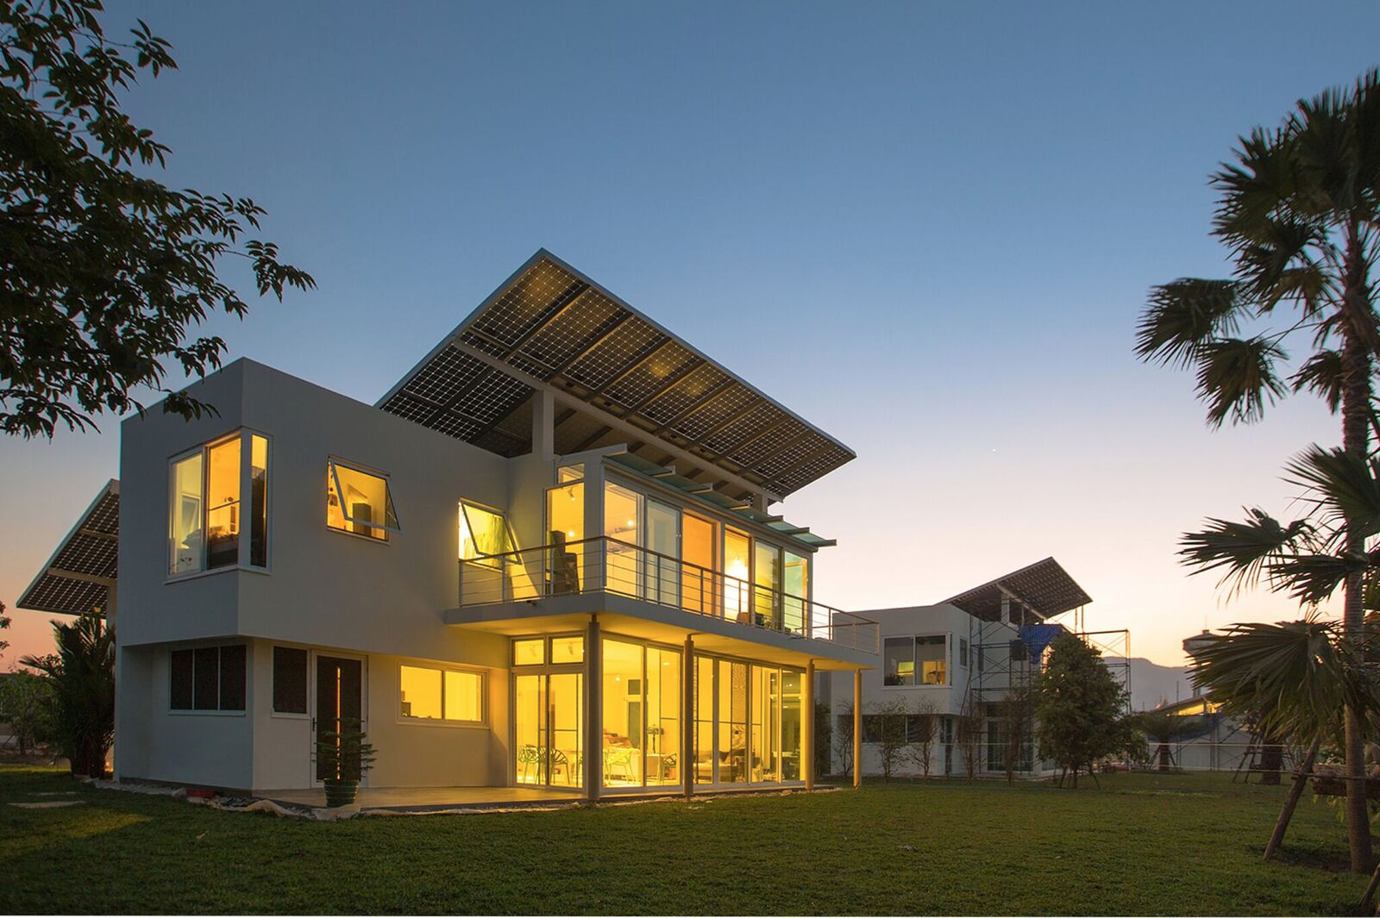
Photo credits (c) Phi Suea House

Slide 2


Slide 3

Content
- Background: CV Arno A. Evers
- Thailand’s energy consumption by sector, 2005-2015
- Thailand’s electricity generation by fuel, 2016
- Thailand Energy Flow in 2011
- Energy infrastructure in Germany 2015 / Comparison 2011 – 2015
- The Grid – German High Voltage Network
- My proposal: Personal Power Providers (3P+)
- Use of a Personal Power Providers (3P+)
- The advantages of New Thinking
- Contact
- Sources
- Additional Information
Hydrogen Energy Summit at Phi Suea House - 26 Jan 18
Off the Grid – Unveiling new ways for our Energy supply

Slide 4
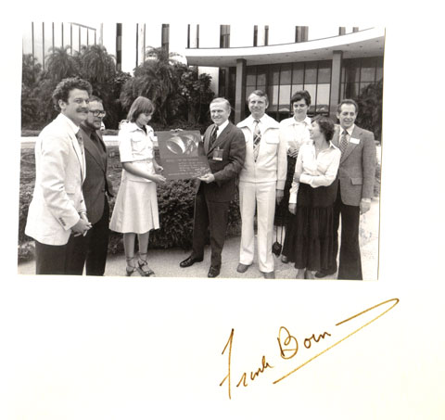
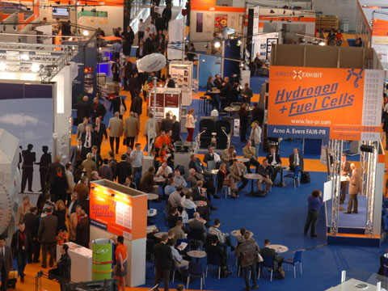
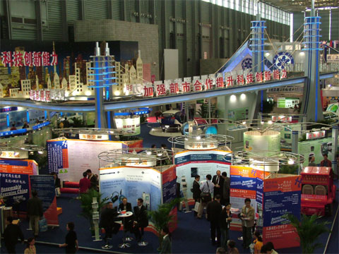
Background I: CV Arno A. Evers
Expertise in Electric/Electronic Systems
- Working on Navigational and Radar equipment in Europe and Persian/Arabic Gulf for seven years ...
Expertise in Press and Public Relations
- 23 years active engagement for promoting the European Airbus Program from the beginning ...
Expertise in Event Management
- Founder (1995) of the Group Exhibit Hydrogen and Fuel Cells at the annual Hannover Fair ...
- Meeting Point Renewable Energies China incl. Hydrogen + Fuel Cells ...
- Group Exhibitions on Aviation, Education and Novel Technologies
Hydrogen Energy Summit at Phi Suea House - 26 Jan 18
Off the Grid – Unveiling new ways for our Energy supply

Slide 5
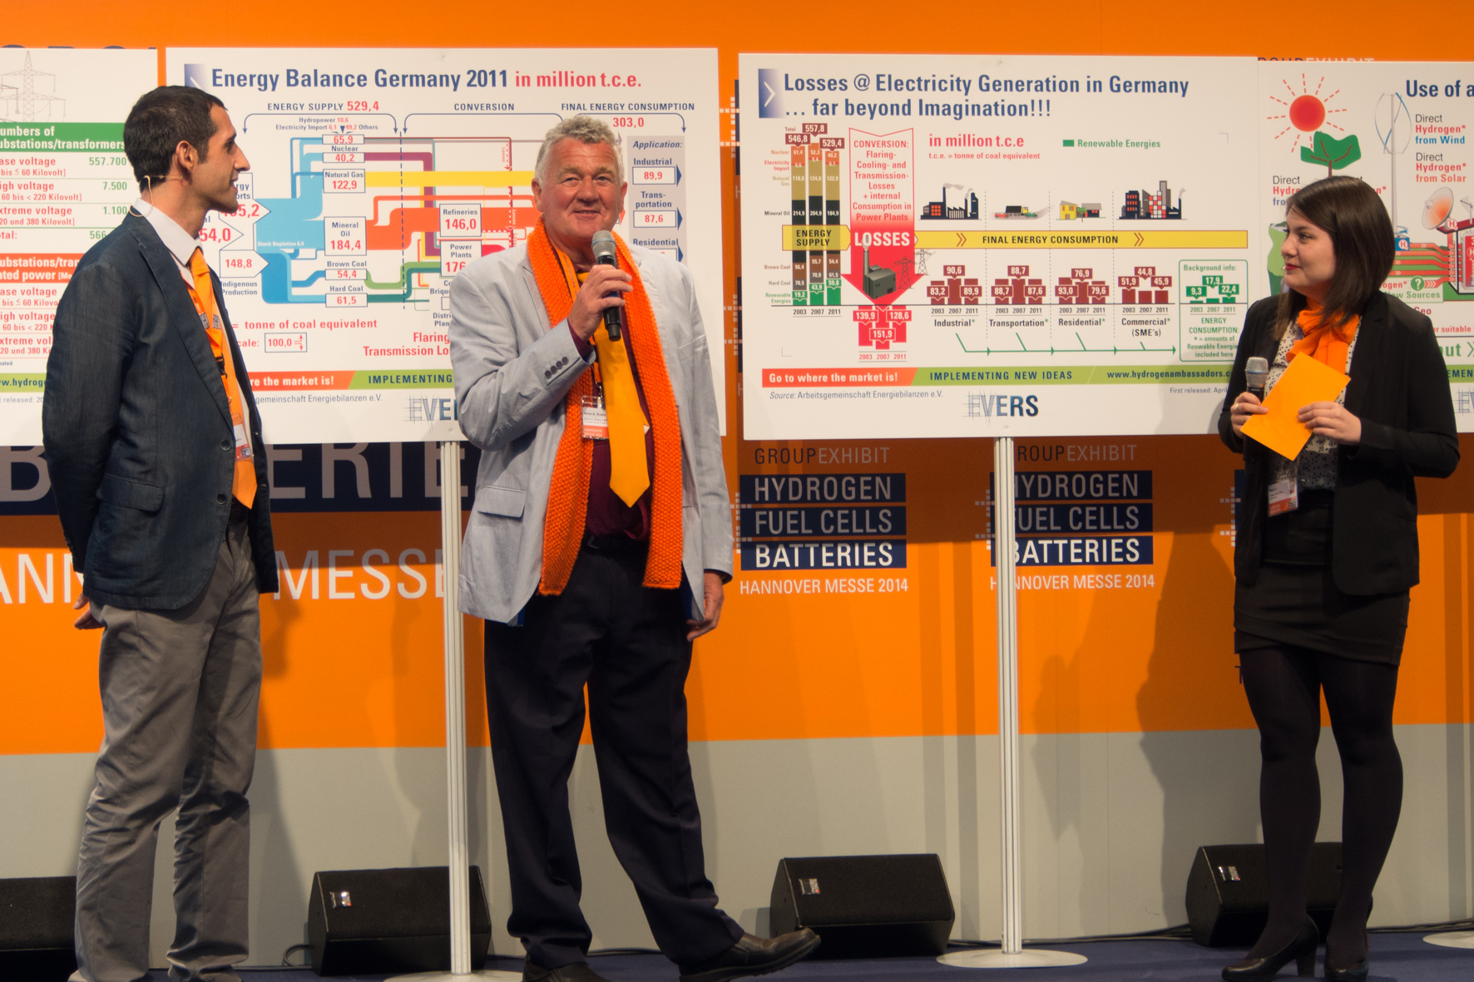
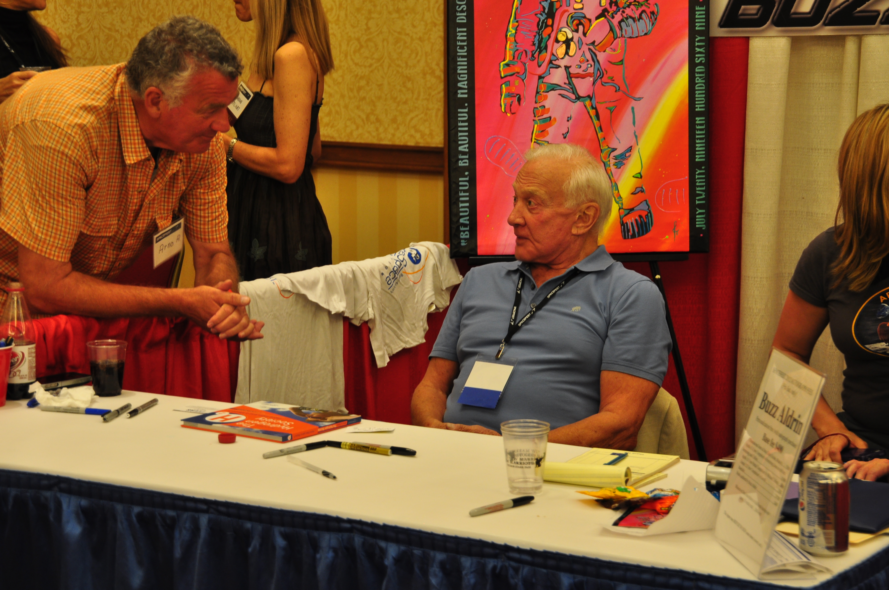

Background II: CV Arno A. Evers
Expertise in Conference Management
- International Energy Summits at the annual HANNOVER FAIR in Germany ...
- International Exchange & Cooperative Seminar / Conference in Shanghai, P.R. China ...
- Realization of a worldwide unique Full-Service-Package ...
The Power of Information
- 100+ objective and unbiased visual aids, backed up by attending international conferences ...
- Interviews, visits and organized workshops all over the world ...
- Author of the book: The Hydrogen Society … more than just a Vision? ...
Hydrogen Energy Summit at Phi Suea House - 26 Jan 18
Off the Grid – Unveiling new ways for our Energy supply

Slide 6
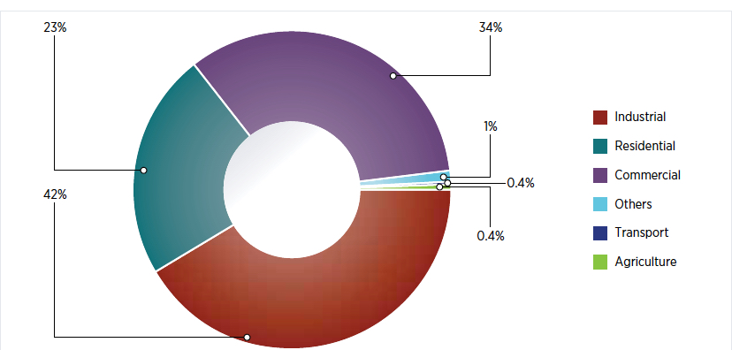
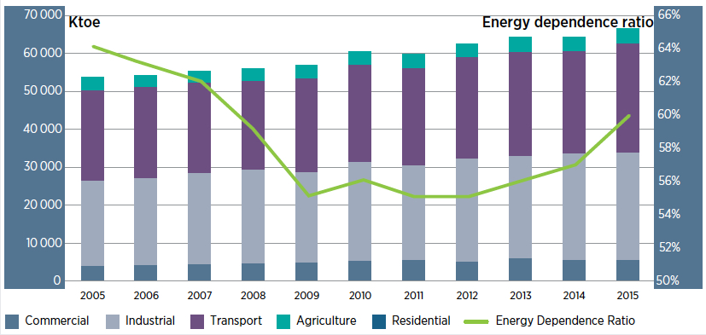
Thailand’s energy consumption by sector, 2005-2015
Source: Based on data from EPPO and DEDE, Ministry of Energy of Thailand / IRENA (2017), Renewable Energy Outlook
Note: ktoe = thousand tonnes of oil equivalent
Hydrogen Energy Summit at Phi Suea House - 26 Jan 18
Off the Grid – Unveiling new ways for our Energy supply

Slide 7
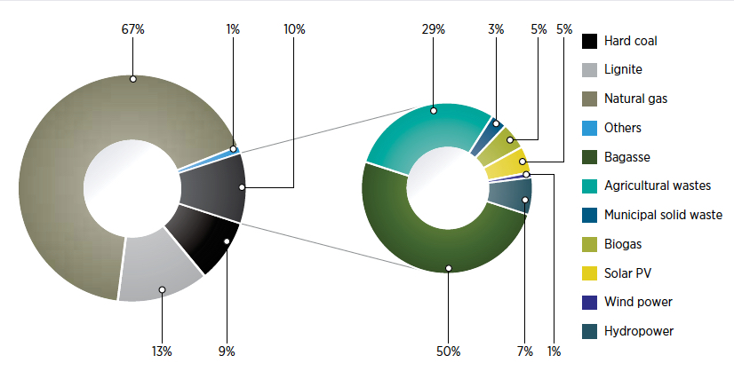
Thailand’s electricity generation by fuel, 2016
Source: Based on data from EGAT / IRENA (2017), Renewable Energy Outlook: Thailand, International Renewable Energy Agency, Abu Dhabi
Hydrogen Energy Summit at Phi Suea House - 26 Jan 18
Off the Grid – Unveiling new ways for our Energy supply

Slide 8
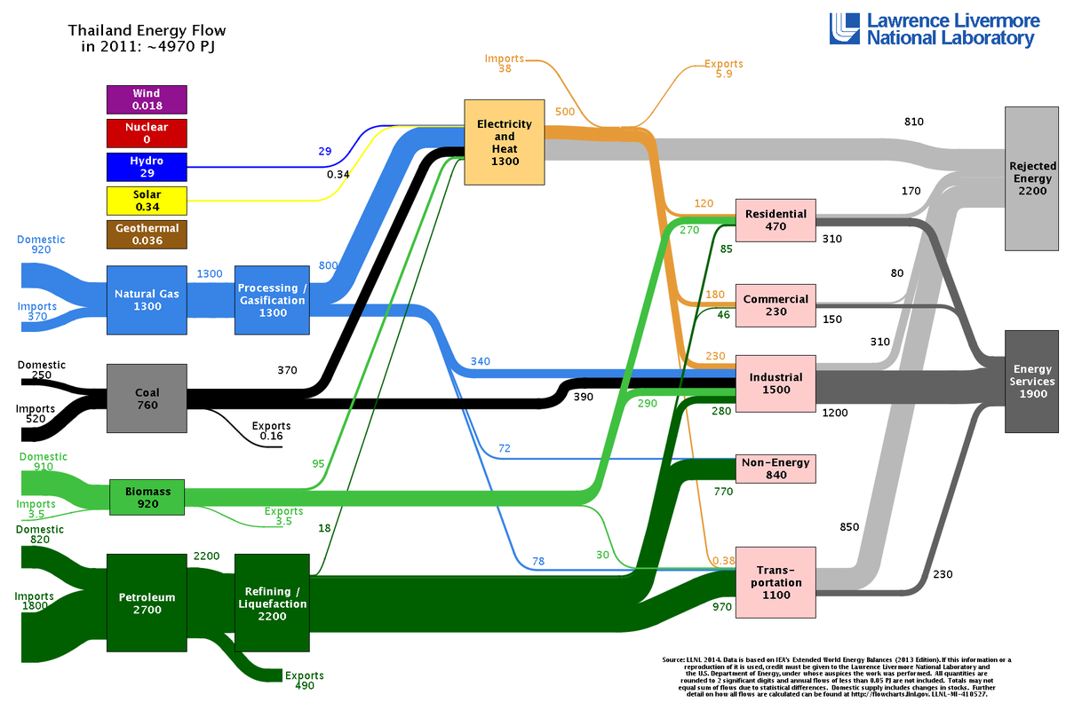
Background:
Thailand Energy Flow
AAE

Slide 9
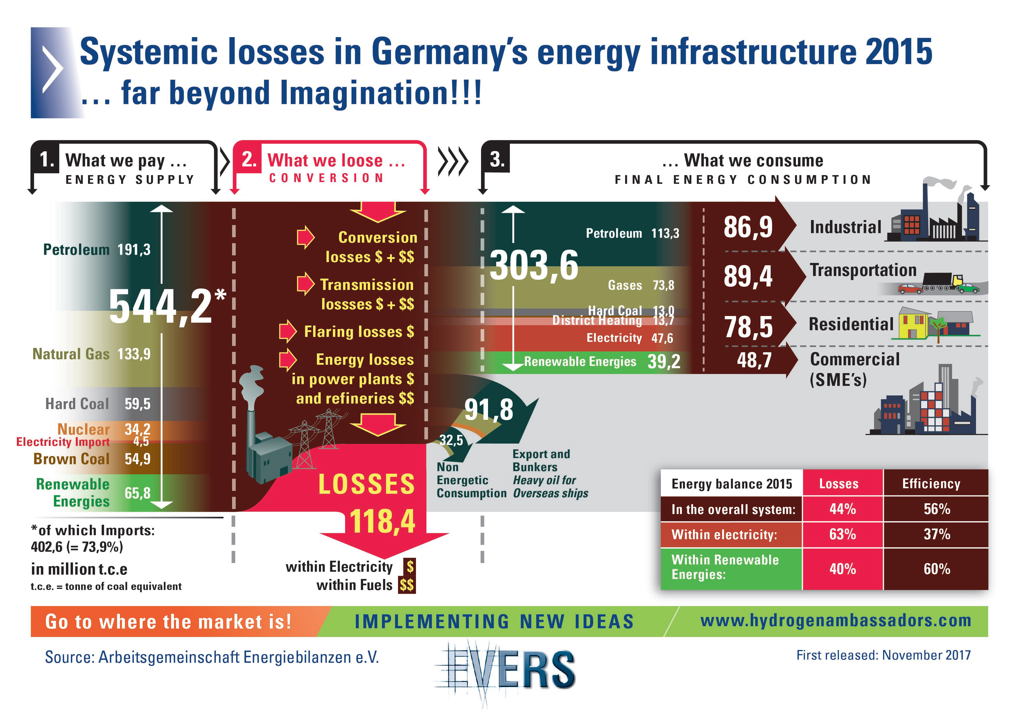
Background:
Thailand
The Futureconference at Phi Suea House - 26 Jan 2018
Off the Grid – Unveiling new ways for our Energy supply

Slide 10
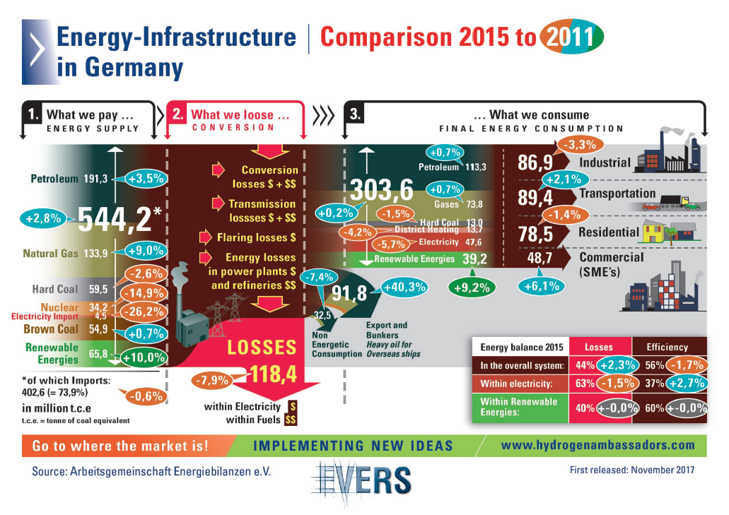
Background:
Thailand
The Futureconference at Phi Suea House - 26 Jan 2018
Off the Grid – Unveiling new ways for our Energy supply

Slide 11
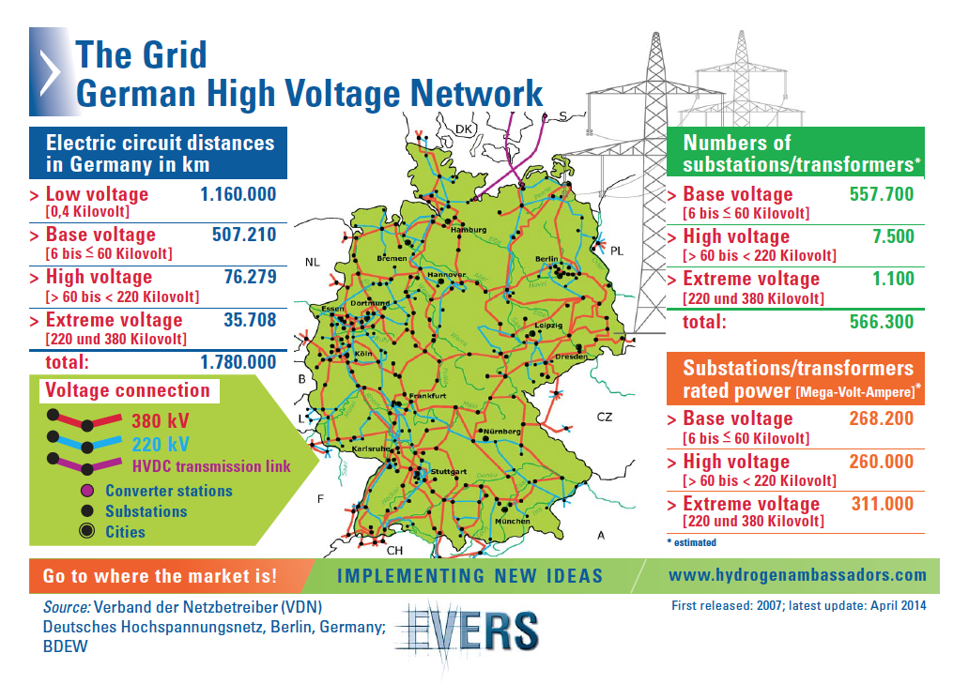
Background:
Thailand
The Futureconference at Phi Suea House - 26 Jan 2018
Off the Grid – Unveiling new ways for our Energy supply

Slide 12
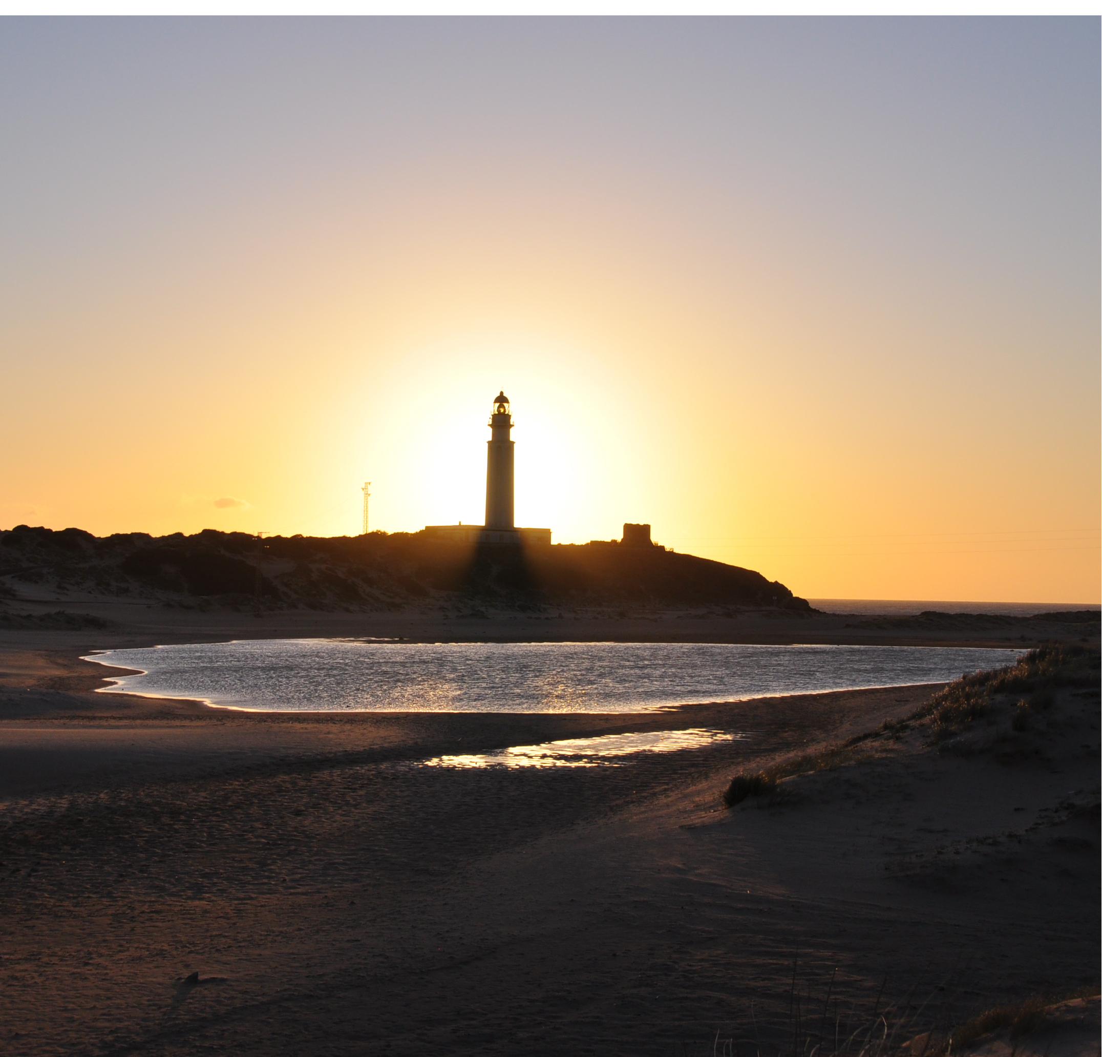
My proposal: Personal Power Providers (3P+)
In order to create a sustainable hydrogen society, hydrogen has to become a common commodity:
It must be produced directly in one conversion step from all locally available “real renewable” primary energy sources.
Collected and stored in Personal Power Providers (3P+), the hydrogen is further utilized in fuel cells to meet all personal power demands for
electricity, transportation, heat and water simultaneously.
There is NO grid connection needed at all.
Hydrogen Energy Summit at Phi Suea House - 26 Jan 18
Off the Grid – Unveiling new ways for our Energy supply

Slide 13
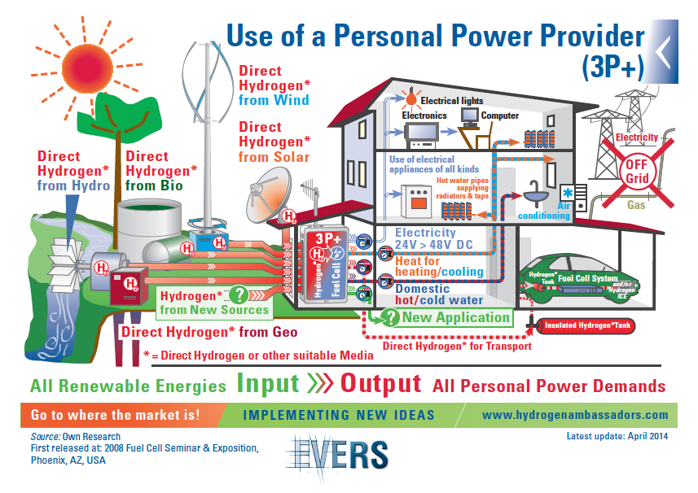
My proposal:
AAE
The Futureconference at Phi Suea House - 26 Jan 2018
Off the Grid – Unveiling new ways for our Energy supply

Slide 14
The advantages of New Thinking I
>>> Today’s production of hydrogen, its distribution, storage and utilization are still dependent upon conventional fossil fuels technologies ...
>>> All known technologies today produce “black hydrogen”, rather than “green hydrogen” which can be made via direct solar energy or other renewables ...
>>> Even when using electricity produced by renewable energies like wind or solar power, the overall efficiency for producing hydrogen by means of electrolysis is still rather uneconomical ...
>>> Grid electricity is by nature always carrying a heavy burden regarding efficiency, reliability and cleanliness ...
>>> The ultimate target for future hydrogen production must be, to use all existing renewable energies to produce hydrogen directly with only one conversion step ...
Hydrogen Energy Summit at Phi Suea House - 26 Jan 18
Off the Grid – Unveiling new ways for our Energy supply

Slide 15
The advantages of New Thinking II
>>> A combination of new photo-biological and photo-chemical processes has to be developed and combined with the implementation of a new system called
Personal Power Provider (3P+). Scalable from mW to MW, the devices can be for collection and storage of hydrogen ...
>>> Utilizing fuel cells to produce low voltage DC electricity, which is used without needing inverters, and also can be used and combined for heating/cooling/cooking ...
>>> Even the water produced in the process can be utilized ...
>>> The intelligent use of smart algorithms and the use of ALL on-site available renewables makes network (grid) connections no longer necessary ...
Hydrogen Energy Summit at Phi Suea House - 26 Jan 18
Off the Grid – Unveiling new ways for our Energy supply

Slide 16
The Phi Suea House is a great example of how sustainable
energy systems can help societies and help people...
It exemplarily shows how the carbon footprint can be reduced, and require less in overall cost ...
This step ahead gives us an excellent example of how to cope in the future ...
I am proud of all, who are involved in achieving this ...
Hydrogen Energy Summit at Phi Suea House - 26 Jan 18
Off the Grid – Unveiling new ways for our Energy supply

Slide 17
Contact
Arno A. Evers
P.O. Box 1710 in 82307 Starnberg
Germany
www.aaevers.com / www.hydrogenambassadors.com
Contact
Telephone: +49 172 832 68 88
Fax: +49 3212 9989243
E-Mail: arno@aaevers.com
Thank you!
Hydrogen Energy Summit at Phi Suea House - 26 Jan 18
Off the Grid – Unveiling new ways for our Energy supply

Slide 18
Sources
Arbeitsgemeinschaft Energiebilanzen AG: www.ag-energiebilanzen.de
Arno A. Evers FAIR-PR: www.hydrogenambassadors.com / www.aaevers.com
DEDE (Department of Alternative Energy Development and Efficiency): www.weben.dede.go.th
EPPO (Energy Policy and Planning Office): www.eppo.go.th
IRENA (2017), Renewable Energy Outlook: Thailand, International Renewable Energy Agency, Abu Dhabi: www.irena.org
Lawrence Livermore National Laboratory (LLNL) Energy Flow Charts: https://flowcharts.llnl.gov/
Phi Suea House: http://www.phisueahouse.com/
Verband der Netzbetreiber e. V. (VDN) – now Bundesverband der Energie- und Wasserwirtschaft e. V. (BDEW): www.bdew.de
Hydrogen Energy Summit at Phi Suea House - 26 Jan 18
Off the Grid – Unveiling new ways for our Energy supply

Slide 19
Additional Information
Hydrogen Energy Summit at Phi Suea House - 26 Jan 18
Off the Grid – Unveiling new ways for our Energy supply

Slide 20
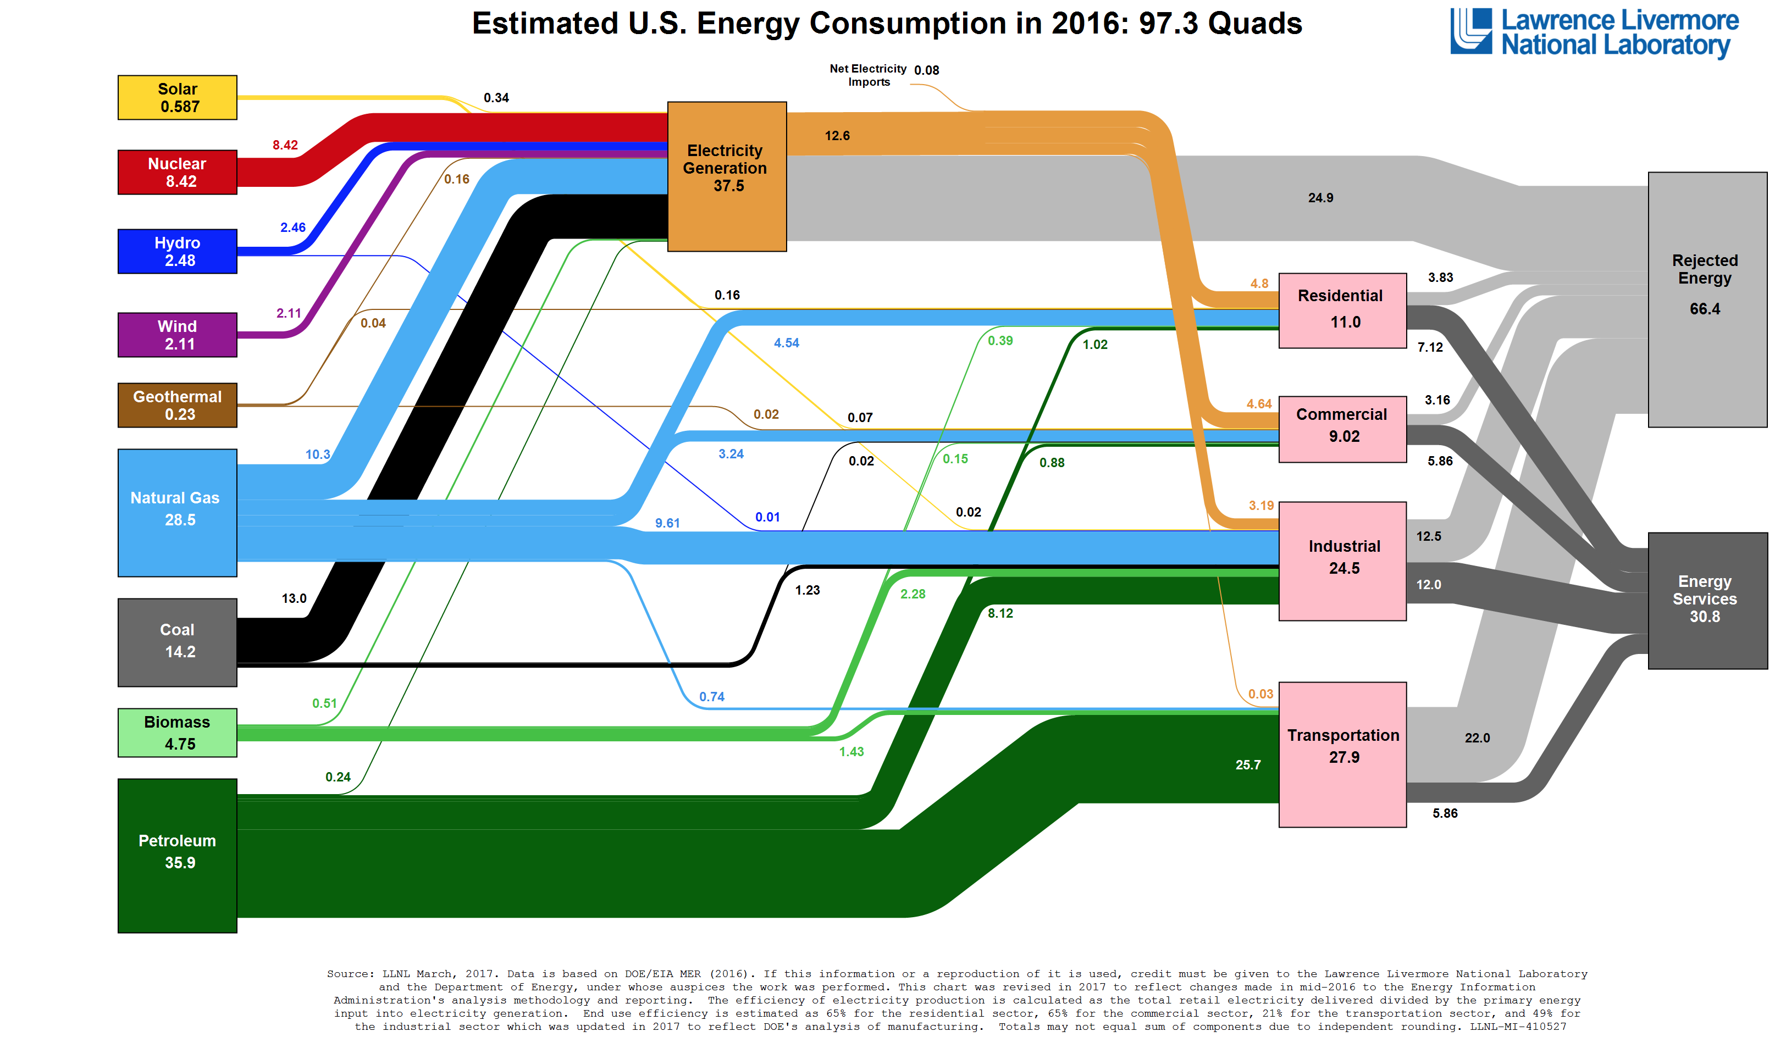
Additional Information
Hydrogen Energy Summit at Phi Suea House - 26 Jan 18
Off the Grid – Unveiling new ways for our Energy supply

Slide 21
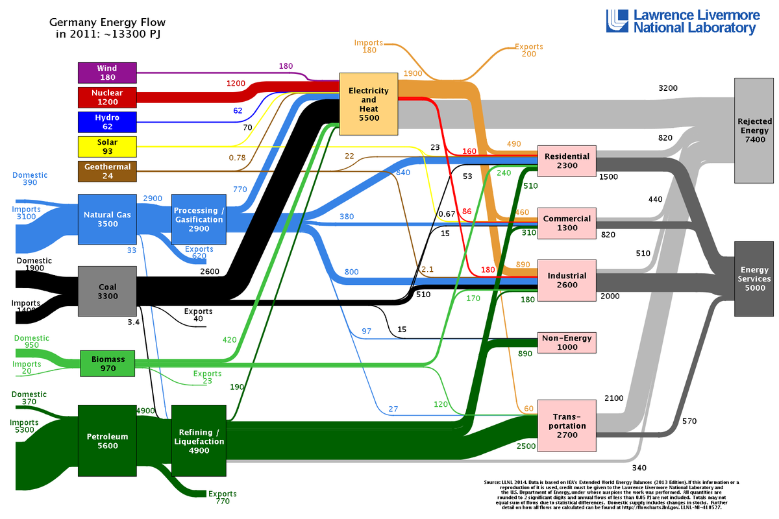
Hydrogen Energy Summit at Phi Suea House - 26 Jan 18
Off the Grid – Unveiling new ways for our Energy supply

